Slide 1
Working with Change; Staying Current When Standards Change
APSG 43 - May 8, 2020
Kris Berglund
Vice-President, Sales

Slide 2
Objectives
How GPS and GNSS technology changed geospatial data accuracy levels
Making old data match new data - common errors we see
iOGP geodetic data guidance for the O&G industry
GIGS (Geospatial Integrity for Geoscience Software)
Future Standards? NGS and NSRS Modernization

Slide 3
GNSS
Global Navigation Satellite Systems
Global Positioning System (GPS) 2000, 24 satellites
GLONASS 1st in 1995, 2nd in 2011, 26 satellites
Galileo 2016, 30 satellites
BeiDou-3 2018, 33 satellites
Regional Satellite Based Augmentation Systems (SBAS)
EGNOS (European Geostationary Navigation Overlay Service)
WAAS (Wide Area Augmentation System - U.S.)
MSAS (MTSAT Satellite Augmentation System - Japan)
GAGAN (GPS Aided Geo Augmented Navigation System - India)
SDCM (System for Differential Corrections and Monitoring - Russian Federation)

Slide 4
Geospatial Data Accuracy
Positional accuracy
Expected deviance in geographic location of object to true ground position
Accuracy
Attribute accuracy
Feature accuracy in
relation to the elements
they represent (soil, forest cover, hydro, etc)

Slide 5
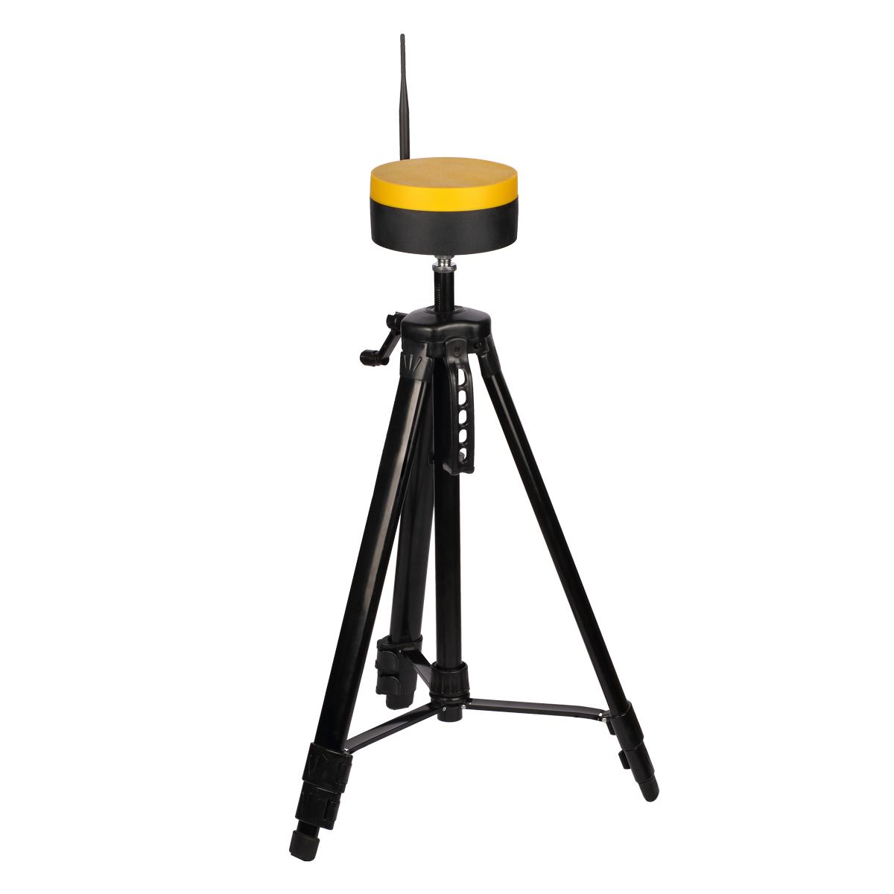
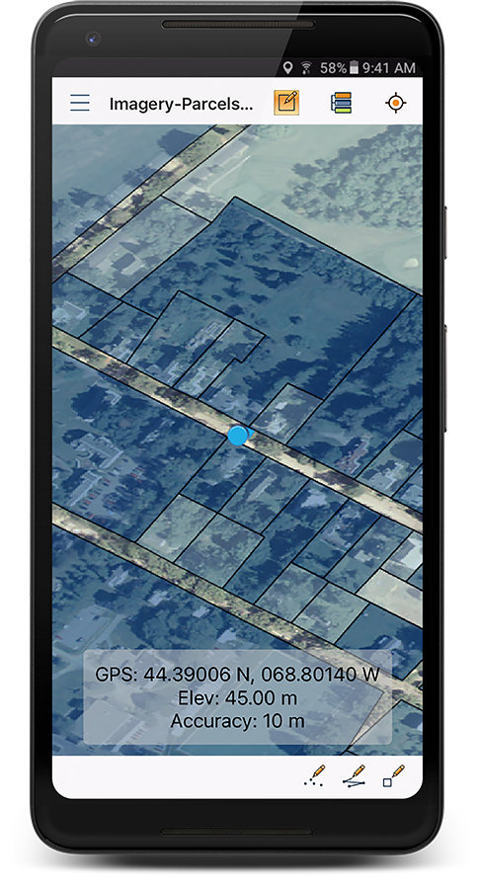
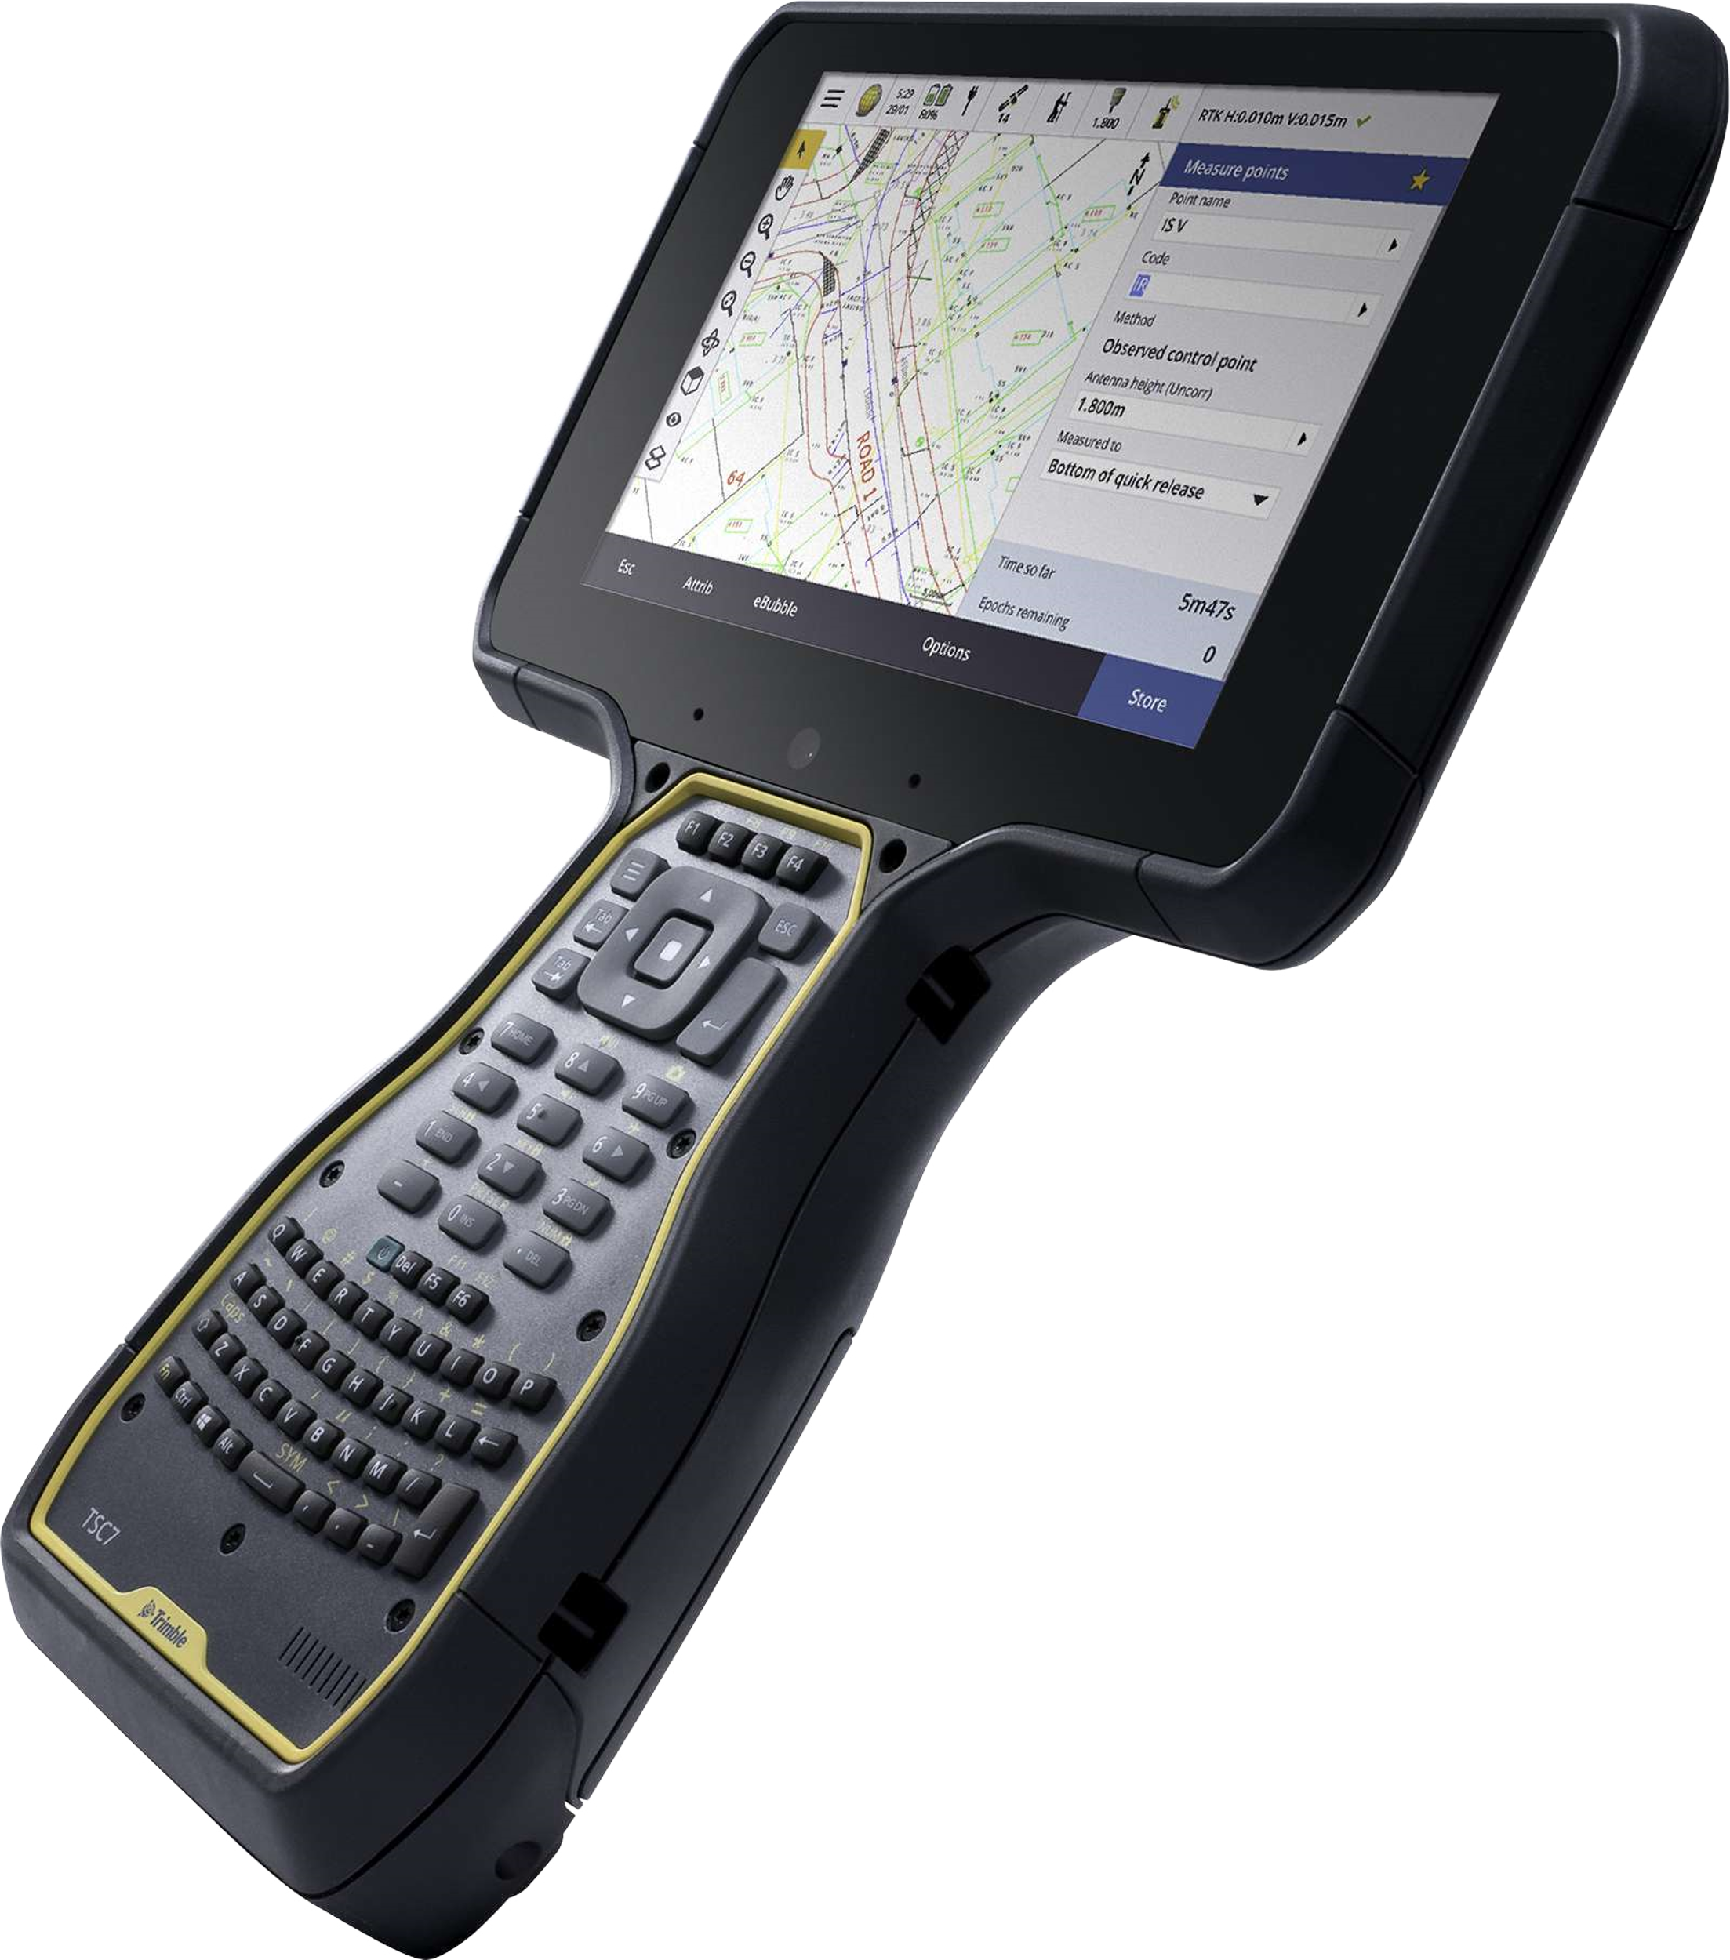
Geospatial Data Accuracy Levels
Consumer grade GPS receivers (+/-3m)
Mapping grade GPS receivers (+/-1m)
Survey grade GPS receivers (+/-1cm/mm)

Slide 6
Common Errors
Datum transformations
Rotation direction & method
Unit settings
Other assumptions

Slide 7
Datum Transformations
Early binding & Late binding datum transformations
Early binding - when transforming from datum A to datum B it uses intermediate datum as a “pivot” system (ITRF, WGS84)
Late binding – No pivot system being used, direct transformation from the source datum to the destination datum
BUT…
What if there is more than one transformation applicable to the two datums? (i.e. ED50 to ETRS89 there are multiple)
Which WGS84? (G730, G873, G1150, G1674, G1762, Transit)
Which ITRF Epoch?

Slide 8
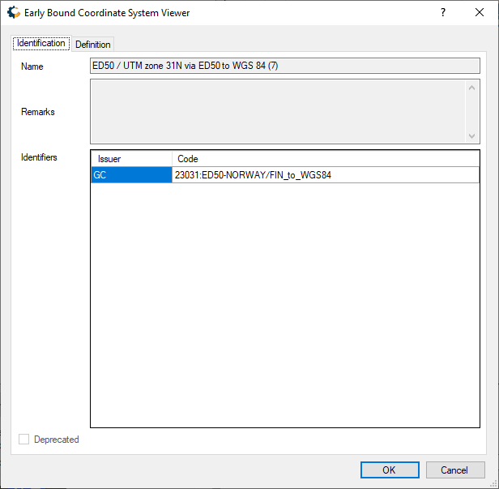
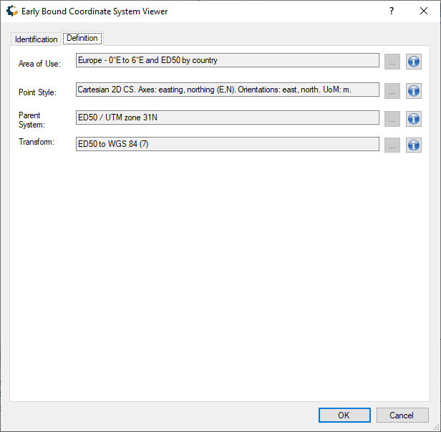
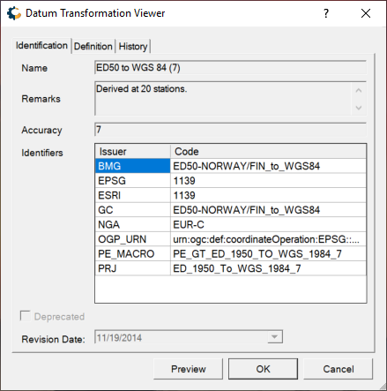
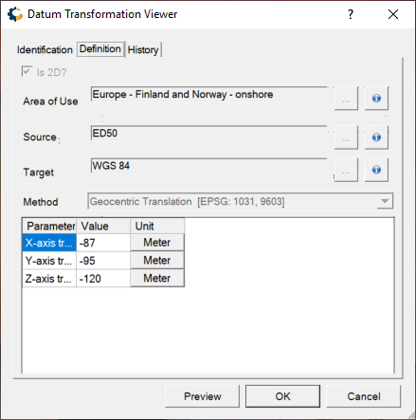
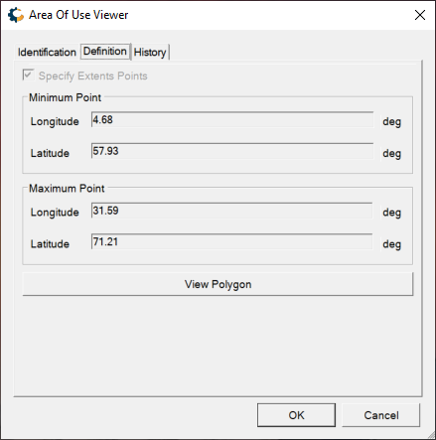
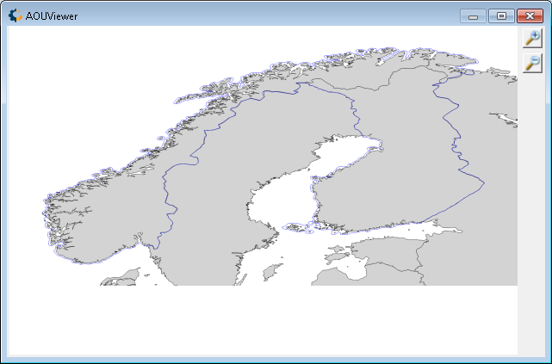

Slide 9
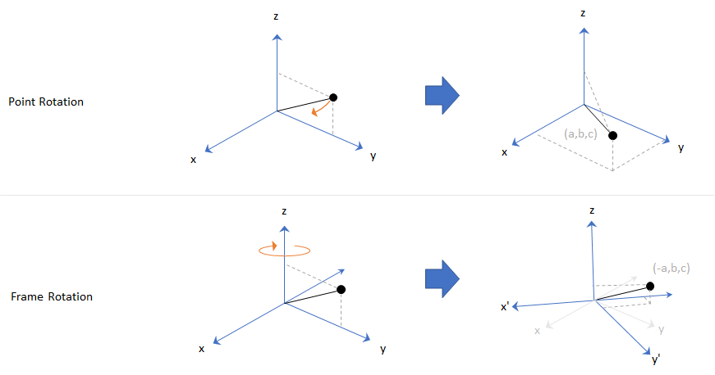
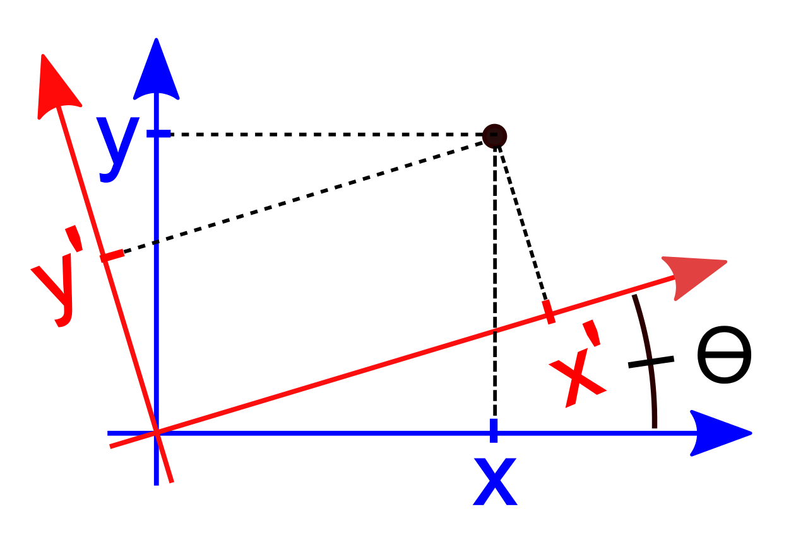
Rotation Direction and Method
Position Vector Rotation
Coordinate Frame Rotation vs. Position Vector Rotation
Related specifically to 7 or 14-parameter datum shifts
Achieves equal results, uses opposite method
CFR is rotating the entire frame around the position
PVR is rotating the actual position
Coordinate Frame Rotation
BUT…
What if one uses CFR when they need PVR?
Reversed signage, improper calculation, bad positioning

Slide 10
Datum Transformation Parameters
Seven (7) Parameter Datum Transformation – shift happens
Delta X, how much shift applied to geocentric X, + or – determines direction
Delta Y, how much shift applied to geocentric Y
Delta Z, how much shift applied to the geocentric Z
Rotation X, denoted by angular units, defines rotation, + or – determines direction
Rotation Y, denoted by angular units, defines rotation shift
Rotation Z, denoted by angular units, defines rotation shift
Scale, denoted by scale parameter
Fourteen (14) Parameter Datum Transformation
Defines the relationship between 2 frames at a given instance in time
Seven velocity parameters applied to the above shift/rotation/scale parameters

Slide 11
Other Assumptions
Assumption of Equivalence
iOGP’s EPSG Geodetic Parameter Registry states:
WGS84 (All realizations), NAD83 (1986), NAD83(NSRS2007), NAD83 (2011),
ITRF (all epochs), GDA94, RGF95, JGD2000, IRENET95, ETRS89, etc…
…About 60 datums, worldwide are coincident at the +/- 1 meter level
Because of this, many tools are set up with that assumption.
Because of this, a lot of people are too.

Slide 12
Geospatial Data Standard Organizations
Well known geodetic parameter dataset of ellipsoids, datums and datum transformations
Accessible online
Maintained by iOGP Geodesy Committee
Positional accuracy standards for digital geospatial data
Digital orthoimagery
Digital planimetric data
Digital elevation data
Data specifications for coordinate reference systems
Defines 2D, 3D, compound CRS
Map projection suggestions

Slide 13
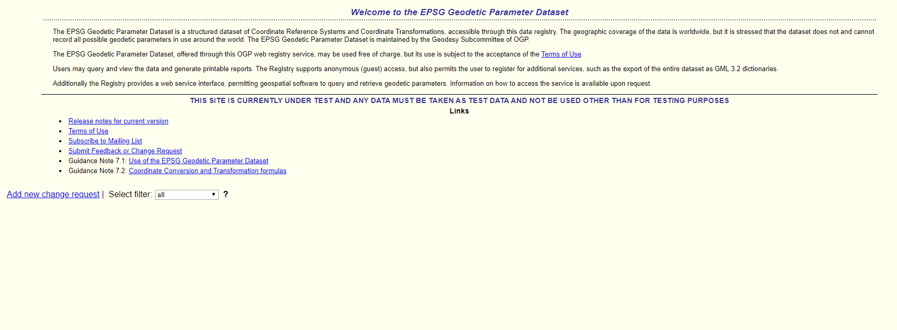

Slide 14
Using a Geodetic Registry
One source of approved geodetic objects
A registry is a central location for locating and verifying the right objects to use
Quickly search and locate objects based on certain criteria
Location
Known Area of Use
Issuer codes (including EPSG codes)
Object names
Object types (units, ellipsoids, datums, prime meridians)

Slide 15
Benefits of Using a Registry
What is the Right Registry?
Single source of truth.
It meets the internal requirements for access, editing & maintenance
Something that supports internal CRS definitions, internal processes
Quickly compare CRS definitions used by other vendors
Use issuer codes to organize valid parameters used by other packages
Sharing Accurate Coordinate Reference System Definitions
Organizational contractors, government partners, regulators, regional authorities
Host your own registry for internal use

Slide 16
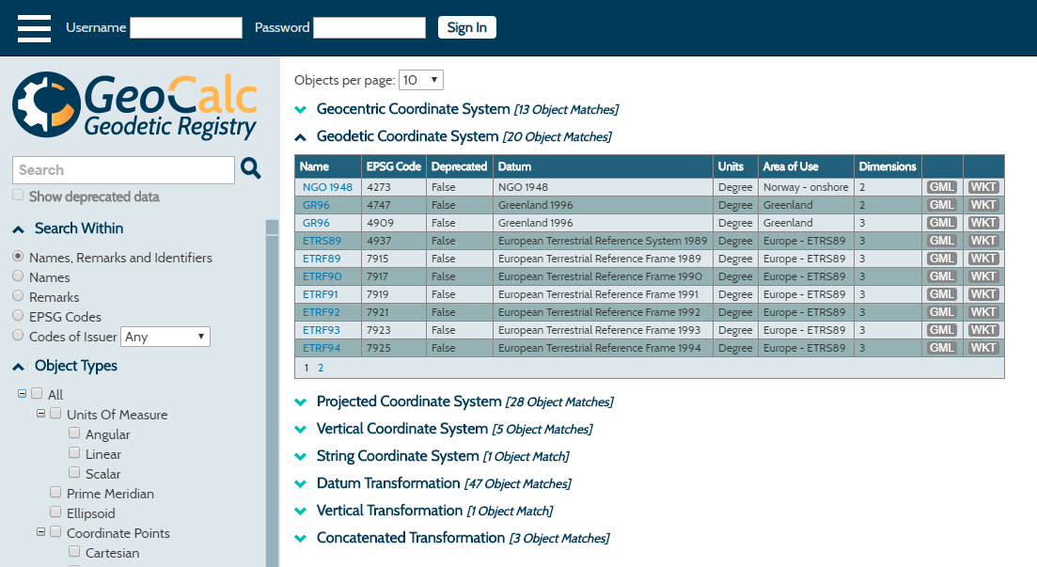
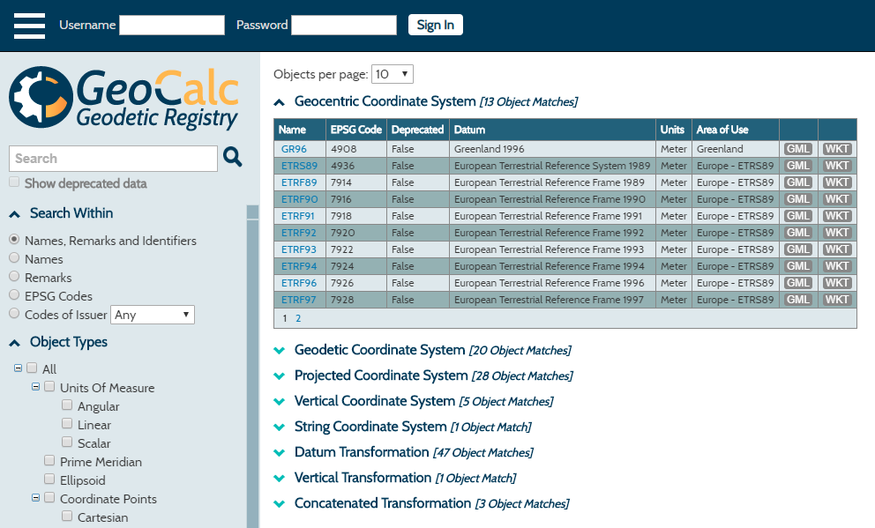
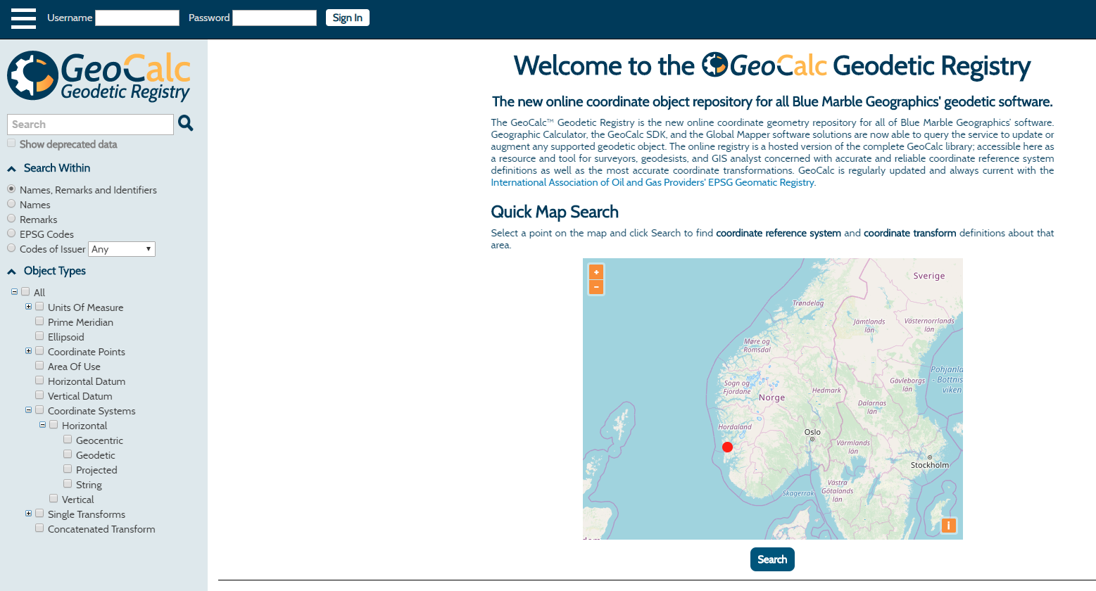
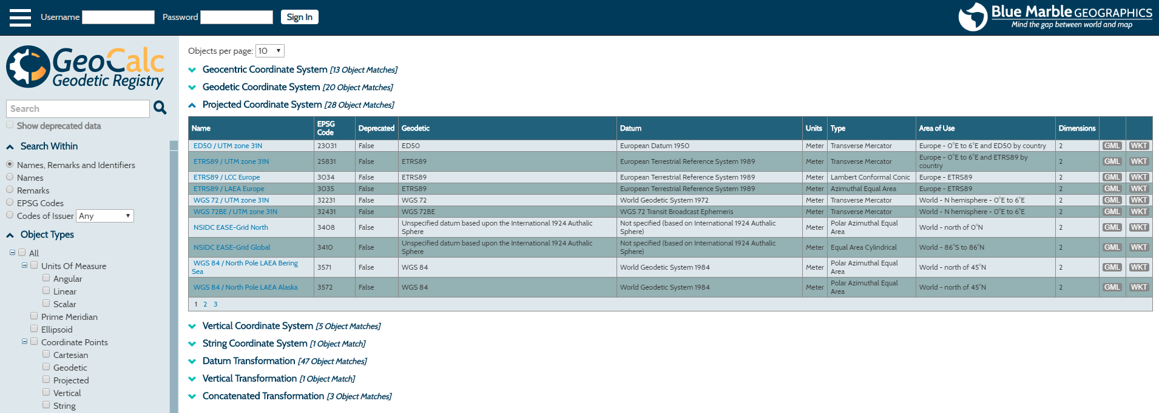
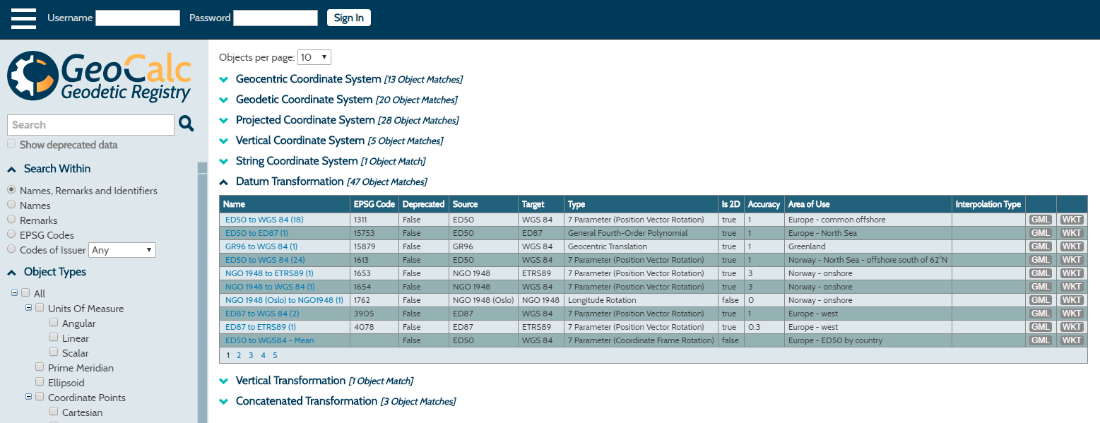

Slide 17
GIGs
Geospatial Integrity for Geoscience Software
Defined
Completeness. Proper geospatial metadata (CRS) required
Correctness. Coordinate precision – free from error
Consistency. Relates to data model, terminology
Verifiability. Audit capability. Have the prior three been achieved?

Slide 18
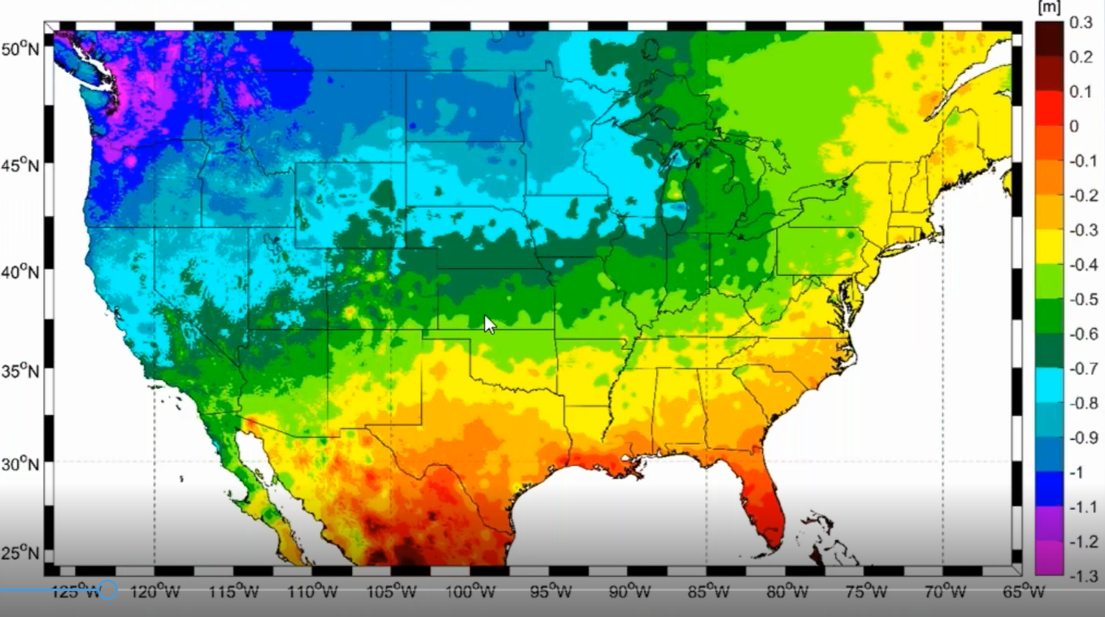
NSRS Modernization
Four plate-fixed Terrestrial Reference Frames (TRFs)
Plate rotation. Tectonic rotation around the Euler Point of a given plate (Euler Pole Rotation)
An ITRF rotation model for each plate to negate plate rotation
NEW PLATE-FIXED REALIZATIONS EVERY FIVE YEARS
Intra-frame velocity models (IFVMs)
Reflects all horizontal motions NOT due to Euler Pole Rotation
Four IFVMs, one for each TRF
Works with Horizontal Time Dependent Positioning (HTDP)
Notes:
IGS = INTERNATIONAL GNSS SYSTEM
Intra Frame Velocity model will be how we compute the change over time to keep positions relative to the plate stable.
NATRF will agree with ITRF on the day it goes live, then will slowly drift away with the plate

Slide 19
Thanks!
Kris Berglund, Vice-President, Sales
kb@bluemarblegeo.com
Notes:
Bring up webinars and YouTube

