Slide 1
PHOTOGRAMMETRIC MODELING OF SUBTERRANEAN FEATURES THOUGH THREE DIMENSIONAL SOFTWARE ANALYSIS
Jorge Sepúlveda,

Slide 2
How easy is it to find information about mapping caves in 3d?
Easy
Takes a bit of googling or journal searching
Difficult to find

Slide 3
Mapping 3D environments or objects
LIDAR: Using lasers to measure distances in a closed space
Pros: Faster to use, More accurate results
Cons: Incredibly expensive for a college students budget
Photogrammetry: Using pictures to create 3D models
Pros: cheaper, everyone has a phone.
Cons: takes longer and requires more precision,

Slide 4
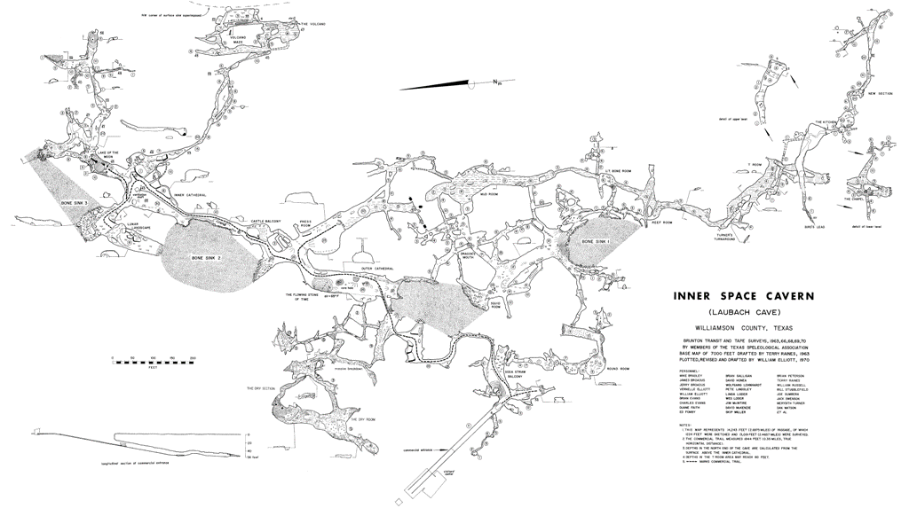

Slide 5
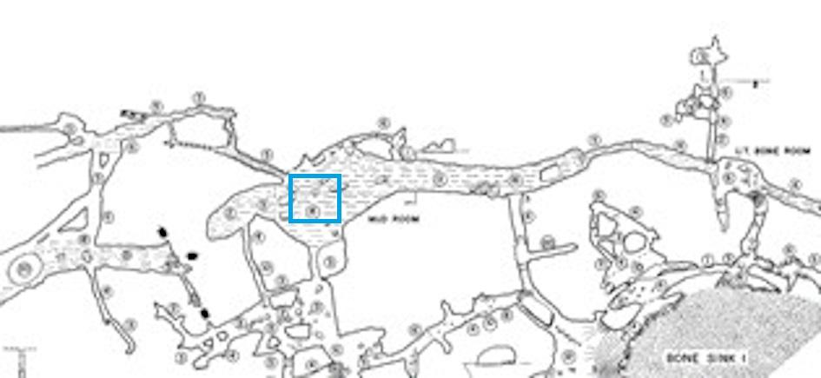
The Plan
Picked out a 15x15m area in the cave.
Took pictures in a drone flight path format for terrestrialll photogrammetry

Slide 6
Flight Patterns

Slide 7
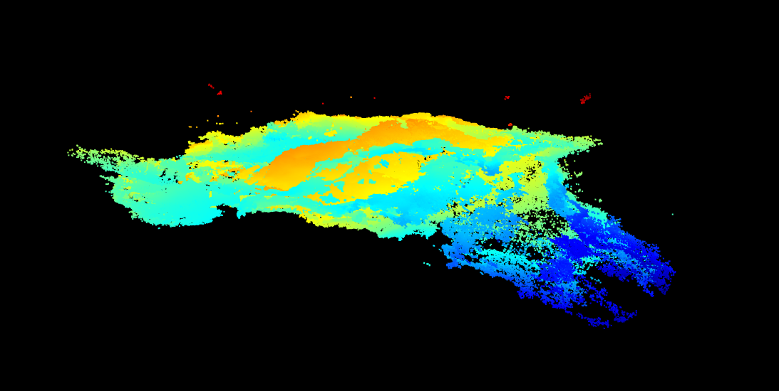
After the pictures, point cloud models were made using Pix4D.
Point cloud models were merged using LAStools.

Slide 8
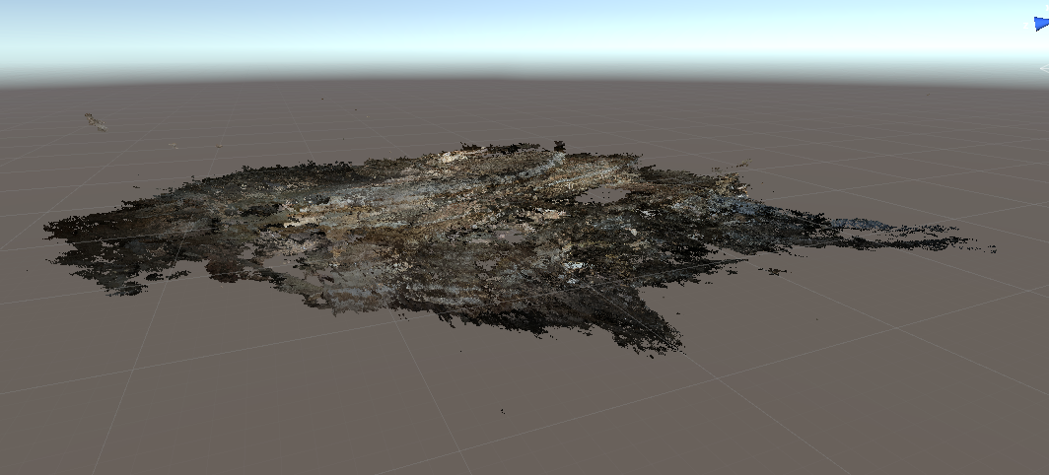
Videogame
The merged point cloud model was converted to a PLY object using Cloud Compare.
PLY object was brought into Unity using PCX.

Slide 9
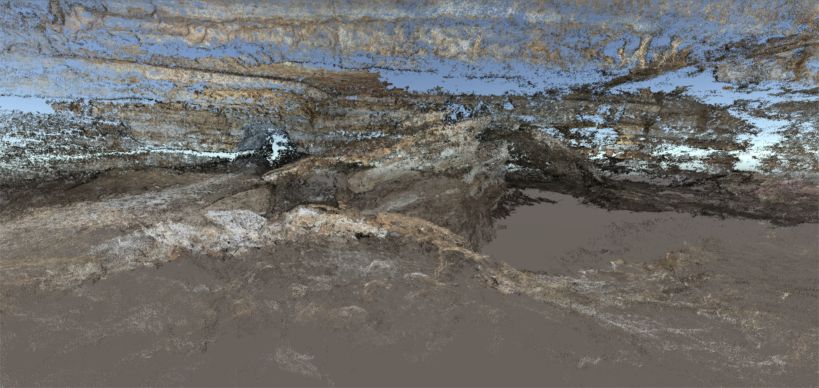
Results
A 3D model was properly rendered and brought into a Unity game
Users can interact in the cave as if they are inside it.
Model has decent accuracy considering only pictures were used.

Slide 10
Closing thoughts
Obstacles such as lighting, topography, and overlapping occurred.
Poor lighting led to certain angle adjustments throughout the process.
Change in topography made it difficult to take pictures.
Overlapping resulted in more defined areas of the produced 3D model.
Nothing is georeferenced because our devices couldn’t talk to GPS
Overall, our iPhone cameras successfully captured an area of Inner Space Caverns to create a 3D model of the cave.

Slide 11
Thank you
Jorge Sepulveda
jorgesepulveda117@tamu.edu

