Slide 1
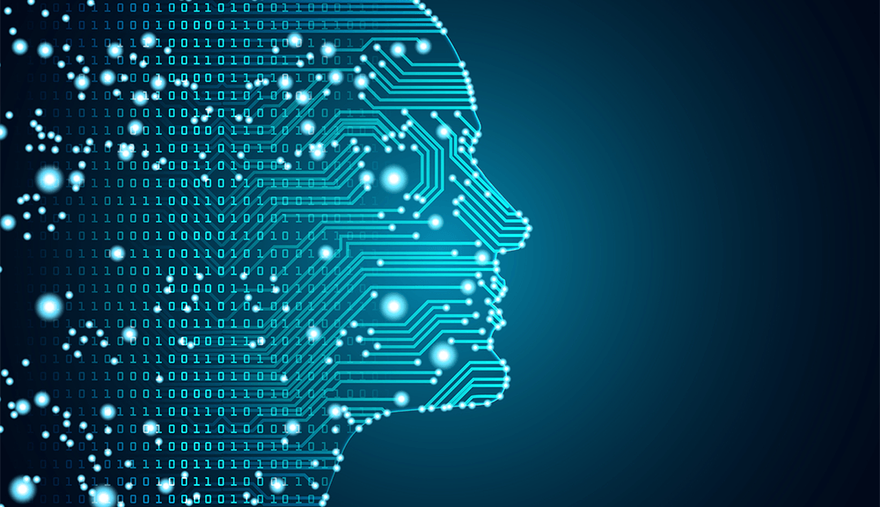

KEEPING YOUR PROJECTS IN MOTION…
1
A.I. – Machine Learning – Deep Learning
Notes:
Introduction – OARS, EIVA’s NA Partner
For the last several years there has been a lot of hype around AI, Machine Learning, Machine Vision, Deep Learning, Neural Networks, and so forth.
These terms get thrown around often with neither the person saying the words, nor the person hearing them knowing what the terms mean exactly.
This presentation will provide a bit of background in these areas and give some current examples of how machine learning and deep learning are being applied to the survey and engineering industries.

Slide 2
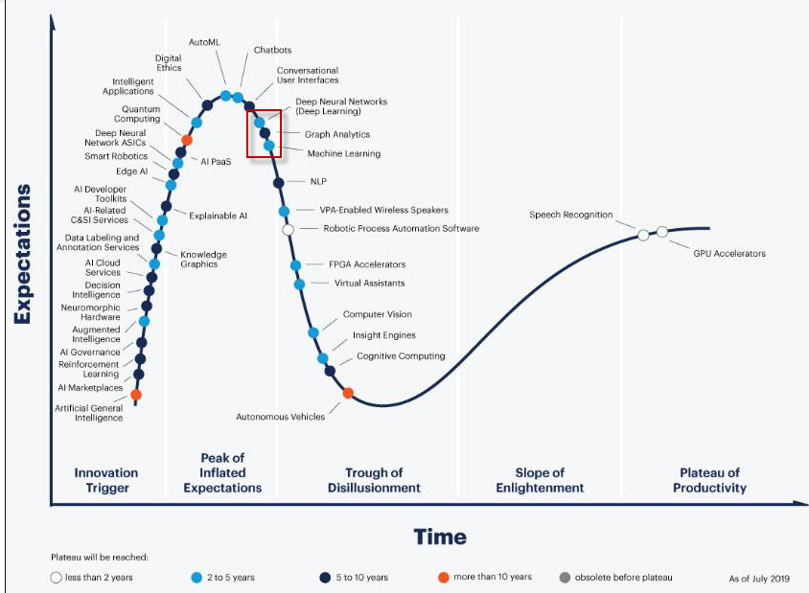
KEEPING YOUR PROJECTS IN MOTION…
1
Notes:
Gartner Hype Cycle is a research methodology that shows the stages that new technologies go through, and it shows that we’re about to get a rude awakening on what Machine Learning can and cannot do. Followed by the reality around the limitations of deep learning. But the fall off into the trough of disillusionment is a human reaction to having such inflated expectations.
One could say that if we were to, um, for lack of a better term, “flatten this curve” of expectations here, you might not go through that tough of Disillusionment there. You have all seen something like that before.

Slide 3
KEEPING YOUR PROJECTS IN MOTION…
1
Software Report Card:
Does Not Work Well With Others
Kevin Tomanka – Business Development Manager
Notes:
The title is a bit of a double entendre in that it suggests Deep Learning is in its adolescence and receiving grade school report cards, and also, that it is a bit misunderstood right now.
So much in computer science is asking the right question, and one of the first questions regarding AI seem to be posed as “Can it do X,Y, or Z” which is the human task at hand.

Slide 4
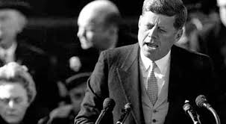
KEEPING YOUR PROJECTS IN MOTION…
1
Software Report Card:
Does Not Work Well With Others
Kevin Tomanka – Business Development Manager
Ask Not…
Notes:
Instead, as this technology grows and advances the question that should be asked is “What is this good at doing, and how else could we apply this effectively?” And that takes understanding of the differences and similarities. When you become aware of what Deep Learning is, and is not, you may start to notice it more and more frequently than you expected in your daily lives.
So Let’s take a look at the history, the differences, and some of the more popular ways of training computers to learn without explicitly programming them.

Slide 5
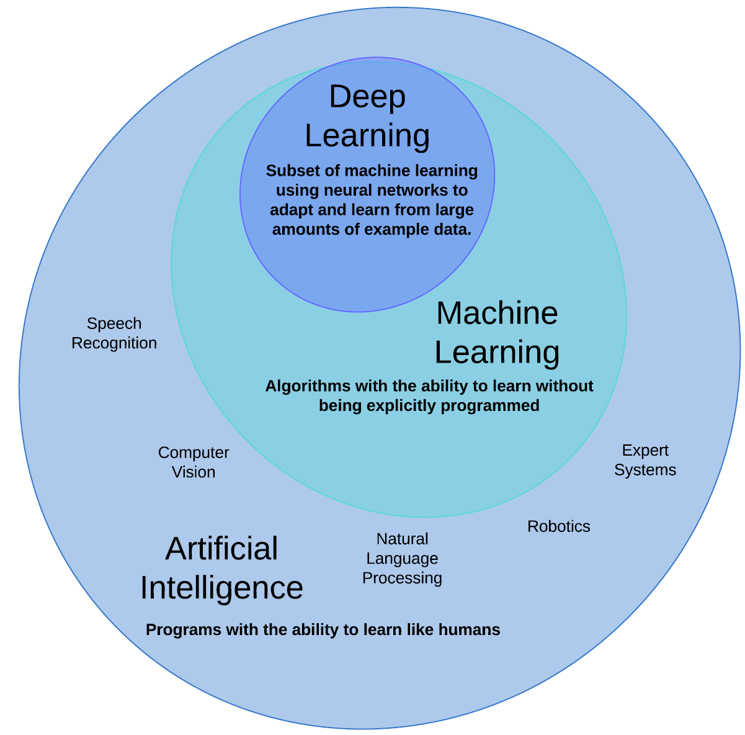
Historical Background
5
Computer systems that can perform tasks that normally require human intelligence.
Artificial Intelligence – 1950’s
Alan Turing’s Theoretical “Imitation Game” (1950)
Computers can play chess and checkers, the first computer program to learn from experience (1952)
First two-layer neural network for pattern recognition (1957)
Deep Blue beats Gary Kasparov at chess. (1997)*
Survey Management
Experienced Personnel
Data Analysis & Management
Notes:
Artificial intelligence is a broader category including many programs that act like humans in different ways.
Robotics is a subcategory that focuses on moving like a human, or computer vision and NLP for seeing like a human, or speech recognition for hearing like a human.
Dates and information courtesy Forbes: https://www.forbes.com/sites/gilpress/2016/12/30/a-very-short-history-of-artificial-intelligence-ai/#77629a5a6fba

Slide 6
Historical Background
5
Computer systems that can perform tasks that normally require human intelligence.
Artificial Intelligence – 1950’s
Alan Turing’s Theoretical “Imitation Game” (1950)
Computers can play chess and checkers, the first computer program to learn from experience (1952)
First two-layer neural network for pattern recognition (1957)
Deep Blue beats Gary Kasparov at chess. (1997)*
Survey Management
Machine Learning – 1990’s
IBM’s Watson Research center publish on statistical-based analysis for machine learning (1988)
Post office uses machine learning for reading zip codes (1990)
Google Search Algorithm proves better than feeling lucky (1998)
Watson eliminates two former champions on Jeopardy! (2011)
Experienced Personnel
Data Analysis & Management
Notes:
Machine Learning is the sub-category of AI that focuses on machines reasoning and learning like humans.
They are algorithms with the ability to learn without being explicitly programmed.
Expand as needed. Post Office, IBM’s Watson was machine learning even though it started to handle very large data sets, it could only do relatively simple tasks, like play chess.
Dates and information courtesy Forbes: https://www.forbes.com/sites/gilpress/2016/12/30/a-very-short-history-of-artificial-intelligence-ai/#77629a5a6fba

Slide 7
Historical Background
5
Computer systems that can perform tasks that normally require human intelligence.
Artificial Intelligence – 1950’s
Alan Turing’s Theoretical “Imitation Game” (1950)
Computers can play chess and checkers, the first computer program to learn from experience (1952)
First two-layer neural network for pattern recognition (1957)
Deep Blue beats Gary Kasparov at chess. (1997)*
Survey Management
Machine Learning – 1990’s
IBM’s Watson Research center publish on statistical-based analysis for machine learning (1988)
Post office uses machine learning for reading zip codes (1990)
Google Search Algorithm proves better than feeling lucky (1998)
Watson eliminates two former champions on Jeopardy! (2011)
Experienced Personnel
Data Analysis & Management
Deep Learning – 2010’s
Google and Tesla begin development of the driverless car (2009)
Handwriting and image recognition nears three-sigma (2011)
Google DeepMind’s AlphaGo defeats Lee Sedol (2016)
Notes:
Deep learning specifically uses neural networks to solve complex tasks. Deep Learning can see trends or correlations that humans cannot.
-Big Data means Deep Learning in most cases.
Dates and information courtesy Forbes: https://www.forbes.com/sites/gilpress/2016/12/30/a-very-short-history-of-artificial-intelligence-ai/#77629a5a6fba

Slide 8

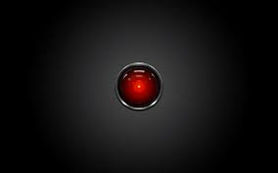
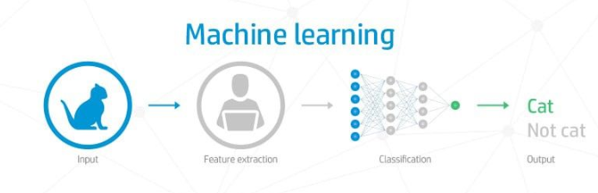
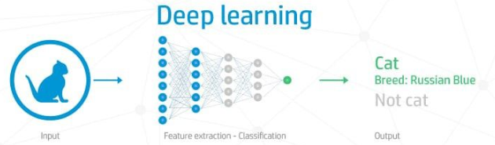
Knowing the difference:
Machine Learning and Deep Learning are both thrown around a lot in conversation, but what is the actual difference between the two?
6
DEEP LEARNING
Subcategory of Machine Learning:
Uses Training Data
Creates Neural Network to handle
multiple complex variables
Requires much more data for training
MACHINE LEARNING
Subcategory of Artificial Intelligence:
Uses Training Data
Predicts Outcomes or sorts
Relatively smaller, classified data sets for training and operation.
Notes:
ML is a subcategory of AI, uses small training datasets to predict the outcome of a future event.
Outcomes can be queried for information and can present quantitative results for their answers.
An example of these results is:
Step 1 extract features. (provides a finite number of features)
Step 2 run each feature through the “Is it a cat” program. Get answer. Yes
Step 3 (if needed) run each feature through the “is it a dog” program. Get answer.
DL is a subcategory of ML, uses large training datasets to create a neural network that perform a larger tasks with multiple variables.
It can only point to a node or nodes and show that it contributed to the result, but there is no label associated with the nodes for the user to interpret.
Step 1 – “name the type of cat in the photo.” Get answer: Russian Blue
-REALLY BIG TRAINING DATA SETS. REALLY BIG SAMPLE SETS: Traditional machine learning breaks down at this point because it has to go through each option with brute force. Neural networks can do multiple sub-tasks at once to achieve a larger goal. Even to the data scientists who work with these things they are very “Black Box.”

Slide 9
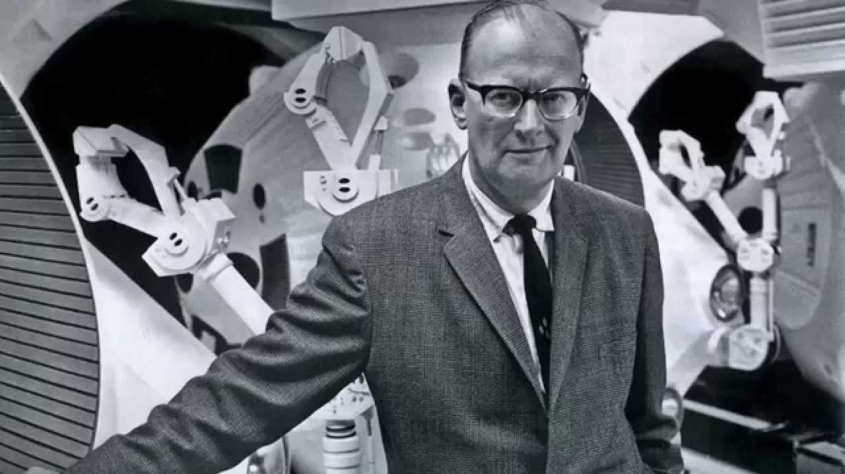
Clarke’s Third Law:
4
“Any sufficiently advanced technology is indistinguishable from magic.”
- Sir Arthur C. Clarke
Notes:
Before we just go handing the keys to the city over to the bots, let’s try to understand them a little better by looking at three ways computers learn without specifically being programmed
(There are more than three ways, but here we will cover three of the main ways that computers can learn.)

Slide 10



How to Train Your Algorithm
(…and then, how to ask it the right questions.)
3
Unsupervised Learning
Supervised Learning
Reinforced Learning
Notes:
Unsupervised learning, supervised learning and reinforced learning.
While Machine Learning exists mostly in the first two, Deep Learning can make use of all three at once to solve powerful problems.
Let’s take a look at the differences between these as well as some applications that are suited for each type of learning.

Slide 11
How to Train Your Algorithm
(…and then, how to ask it the right questions.)
3
Unsupervised Learning
Trends and patterns are found without being given specific output parameters.
Application: “Sort these animal pictures by species.”
Supervised Learning
Reinforced Learning
Notes:
Unsupervised learning. This is when you give a computer a set of data and ask it to find correlations.

Slide 12
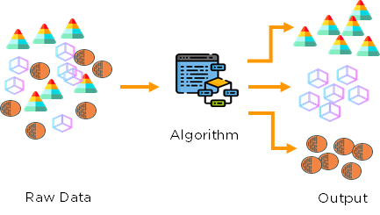
How to Train Your Algorithm
3
Steps for unsupervised learning
No previous data for training
The algorithm sees patterns in the new incoming data and attempts to classify by type.
Output type is unlabeled, only sorted by similar features
Notes:
This is great for real-time monitoring or analysis with many unknown and unlabeled variables. Think of this as “Sort the Skittles” if you’ve ever given a kid a bag of skittles, looked back and they were sorted by color, that’s some unsupervised learning right there.
The computer can sometimes sort things in ways that humans would have not been able to see. And you can train it to sort things differently, and you can give the output labels after the fact but the algorithm will not know the label, only the properties that made the object like the others in the group.
To be clear:
You cannot expect this type of algorithm to find something for you by name, or predict the likelihood of an event happening. Ask Unsupervised ML Algorithms to sort things into groups for you.

Slide 13
How to Train Your Algorithm
(…and then, how to ask it the right questions.)
3
Unsupervised Learning
Trends and patterns are found without being given specific output parameters.
Application: “Sort these animal pictures by species.”
Supervised Learning
Supervised by either Human or Computer based trainer with the answers to the questions.
Application: “Is this an image of a Cat?”
Reinforced Learning
Notes:
Supervised learning is providing a smaller labeled data set for training and then having the program predict a future outcome based on previous experience. Flash cards are how humans experience Supervised Learning.
Supervised Learning by another computer is still considered supervised learning.

Slide 14
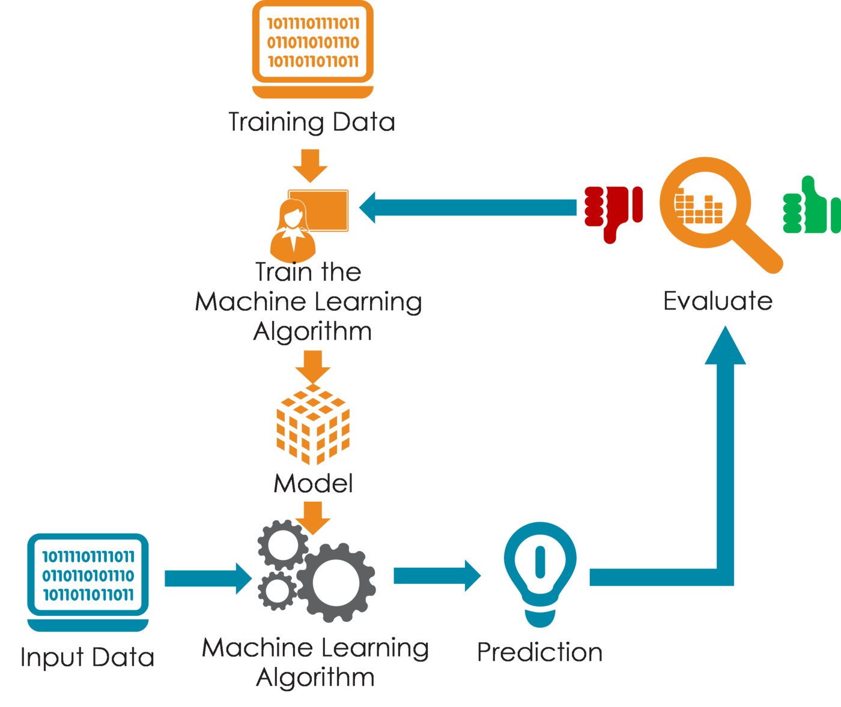
How to Train Your Algorithm
3
Steps for Supervised Learning
Collect a data set that includes “labels” (answers)
Train the algorithm with the data to create the model
Input new data and check the results. If not correct, change training data to include new examples and train again.
Notes:
With supervised learning a training dataset is provided with labels. The algorithm uses the model to predict the outcome when it experiences a new input.
Here’s one example: feed a language recognition algorithm examples of good hotel reviews and bad hotel reviews, labeled accordingly. Then, the algorithm will be shown a hotel review it has never seen, [the input data], and guess if it is positive or negative.
If you wish to change the algorithm you must add or remove data from the training set and retrain the algorithm and retrain from the beginning. Another computer can be the ‘trainer’ in this model, it’s still supervised learning. In that case a sample test is included along with the training data and the computer will test itself for accuracy as it trains.

Slide 15
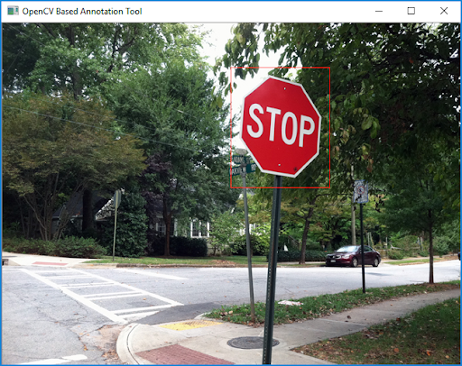
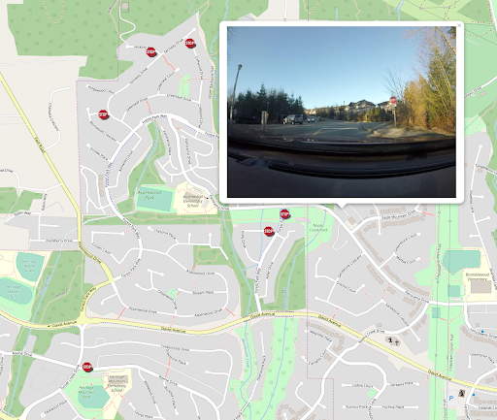
FME using Machine Learning for Image Recognition
U S E C A S E #1
7
Supervised learning recognizes stop signs in photos and places geo-referenced locations in database
OpenCV is used for object detection and then combined with GPS Coordinates to place pins in a geospatial database. There are a few different libraries now becoming accepted standards for image recognition.
Size Matters
Machine Learning is much faster to train than deep learning due to the amount of data needed to train up deep learning models. However, the advantage breaks down on very large data sets.
Only Finds Known Objects
Must be trained with small datasets of examples to begin to recognize objects in future data.
Not Spoof-proof
While performing rather well on defaced stop signs, these algorithms can be spoofed intentionally or unintentionally by the environment creating false-positives.
Notes:
FME is a database injection tool that brings data into geospatial databases, in this instance it is looking at photos from video data driving along streets and it is finding the stop signs along the way. Combined with GPS Sensor data, the program can recognize a sign and input the location into the database.
The size of the dataset matters, if you were finding more than just signs, it would be a task too great for Machine Learning and better fit for Deep Learning.
If you were classifying every single sign that was encountered, you would have to do so much brute force calculation so quickly that it would soon get bogged down and not be possible in city conditions where signs are all over the place. Plus there’s the question about what happens when brand new sign type appears?
Machine Learning can only classify objects that it finds, and it can only classify objects that it knows, so if it experiences something completely new it will theoretically not take any action, in some occurrences it may take a guess at labeling it but will label it incorrectly because it doesn’t have that word in its vocabulary.

Slide 16
How to Train Your Algorithm
(…and then, how to ask it the right questions.)
3
Unsupervised Learning
Trends and patterns are found without being given specific output parameters.
Application: “Sort these animal pictures by species.”
Supervised Learning
Supervised by either Human or Computer based trainer with the answers to the questions.
Application: “Is this an image of a Cat?”
Reinforced Learning
An algorithm performs actions over time and learns based off (user defined) rewards it receives.
Application: “Show me other images like the one I’m about to show you.”
Notes:
The third type of learning is reinforced learning, and this is where we’re specifically going to talk about Deep Learning and Neural Networks.
Remember that deep learning can’t tell you why it decided something, it can only point to a non-labeled node as the source of the decision.
Application: “Show me other images like the one I’m about to show you.”
[Throw a mountain of data at it and stand back]

Slide 17
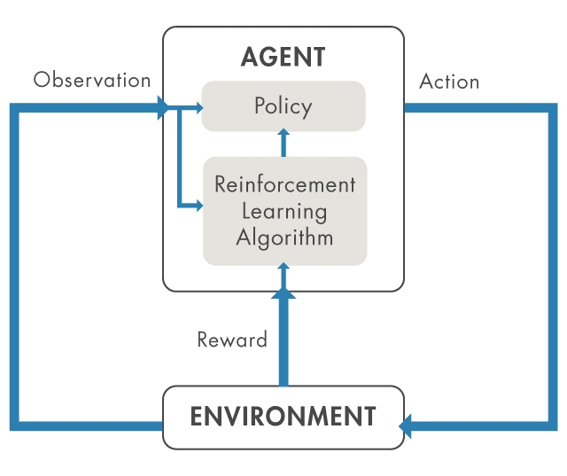
How to Train Your Algorithm
3
Steps for Reinforced Learning
Create the environment and define a reward. (set a clear goal)
Create and validate the agent (give it powers)
Add lots and lots of data
Stand back and watch what happens
Notes:
Reinforced learning, the steps here are create the environment. This is “asking the question.” Keep in mind that you must ask the question in the proper way to set up a good environment.
Then create and validate the agent. That is, set the parameters that it can work with. And then stand back and watch what it does.
If this were a Pavlov situation, the Agent would be the dog, the environment would be the bell the observation would be the dog hearing the bell, the action would be the dog salivating, and the food would be the reward from the environment.

Slide 18
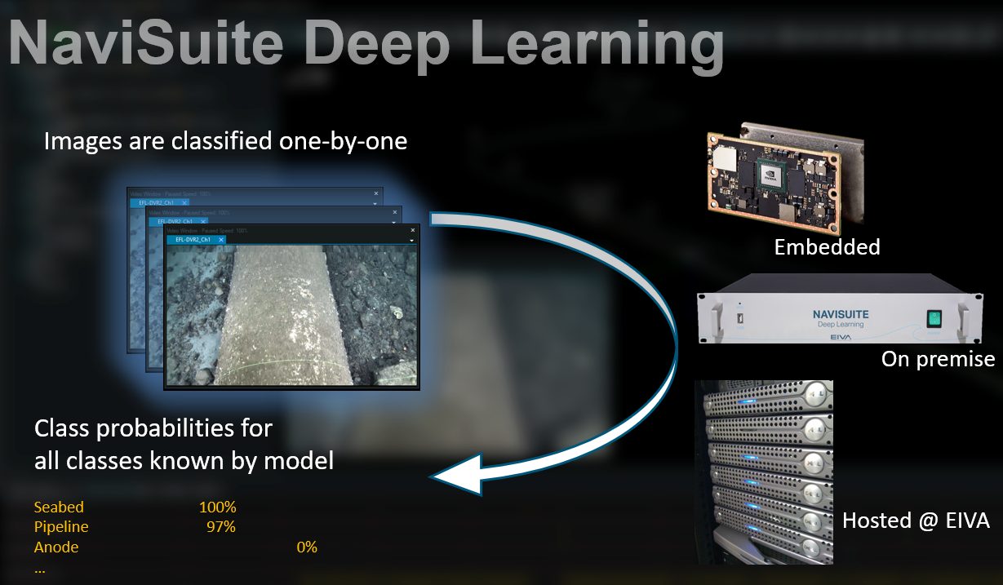
EIVA Deep Learning for Pipeline Inspection
U S E C A S E #2
8
Is now maturing the algorithm from detecting an anode to detecting the percentage of depletion on the anode. Current accuracy is around 80% when compared to CP stabs.
Not just for Pipelines
Currently the Oil and Gas industry has been the primary participant in the development of the algorithm. Initial Eel Grass and coral reef studies are currently being worked on. Plants, fish, and other biology will be an obvious next step.
Instance segmentation
Powerful classification that puts out labeled data for over 30+ types of objects. The output is georeferenced with probability estimates.
Zen-like concentration
Looks at each frame individually, unlike humans the program cannot sense temporal rhythms. Baseline dataset would be required to sense missing objects.
Notes:
This is a deep learning algorithm that can be run on a piece of hardware that is owned, or on EIVA’s server in the cloud. It can detect 30+ types of objects common in subsea pipeline inspection and IRM activities and classify them with labels and probabilities.
Right now the O&G industry is the biggest participant in this algorithm, but there are many applications for biologists to use this same tool so stay tuned for how fisheries and biology can use this same tool to their advantage.
One disadvantage is the ability to be intuitive. Each frame exists out of time from the rest. A human can get in a rhythm of marking a field joint or an anode every 12 meters, and if one is missed they will sense that it’s been a too long since they’ve seen an anode on the screen. Deep Learning cannot know this unless it was give some kind of baseline such as an as-built to reference and compare against.
We are going to use this example to show the steps of how you would develop a deep learning model. First you will start with a single division, in this case it is going to be Man Made or Natural objects, since everything subsea falls into one of those categories.

Slide 19
Training Images
4
Notes:
Start by defining the non-pipe area, then ask it to define the non pipe area until it begins to guess correctly with a very high accuracy.

Slide 20
Training Images
4
Notes:
Then Define the pipes

Slide 21
Training Images
4
Notes:
Train it until it is as good at tracking pipes in images as humans are. This includes low resolution and low visibility situations.

Slide 22
Deep Learning Nodes
4
Pipeline
Pipeline
Features
Man Made
Debris
Seabed
Natural
Not Seabed
Notes:
A young deep learning model might look like this.
From here the decision can be taken about the man made or the natural features. Right now this looks like a basic Machine Learning algorithm, but it will continue to connect nodes as the training goes on.
The users are only controlling the green outputs, they really have no control over the two nodes in the middle, their actual name has no significance to the user, it might as well be a single black box.
Here are some examples of data that was fed into the system with some guidance from the environment.

Slide 23
Training Images
4

Slide 24
Training Images
4

Slide 25
Training Images
4

Slide 26
Deep Learning Nodes
4
Field Joint - OK
Pipeline
Field Joint - Damaged
Field Joint
75-100%
Pipeline
Features
Anode
Man Made
50-75%
Debris
<50%
Rock - Round
Seabed
Rock Type
Rock - Jagged
Natural
Rocks
Rock < 20cm
Rock Sizes
Rock > 20cm
Fish
Notes:
Next we will get it to start recognizing more and more objects, and this is where Deep learning starts to separate from Machine learning. In reality this would begin to become more etherial in the sense that the blue nodes in the middle would no longer be labeled.
If someone wanted to use this algorithm to classify fish or coral, it could be expanded without degrading the accuracy or speed of the current model. The only increase will be in the length of training.

Slide 27
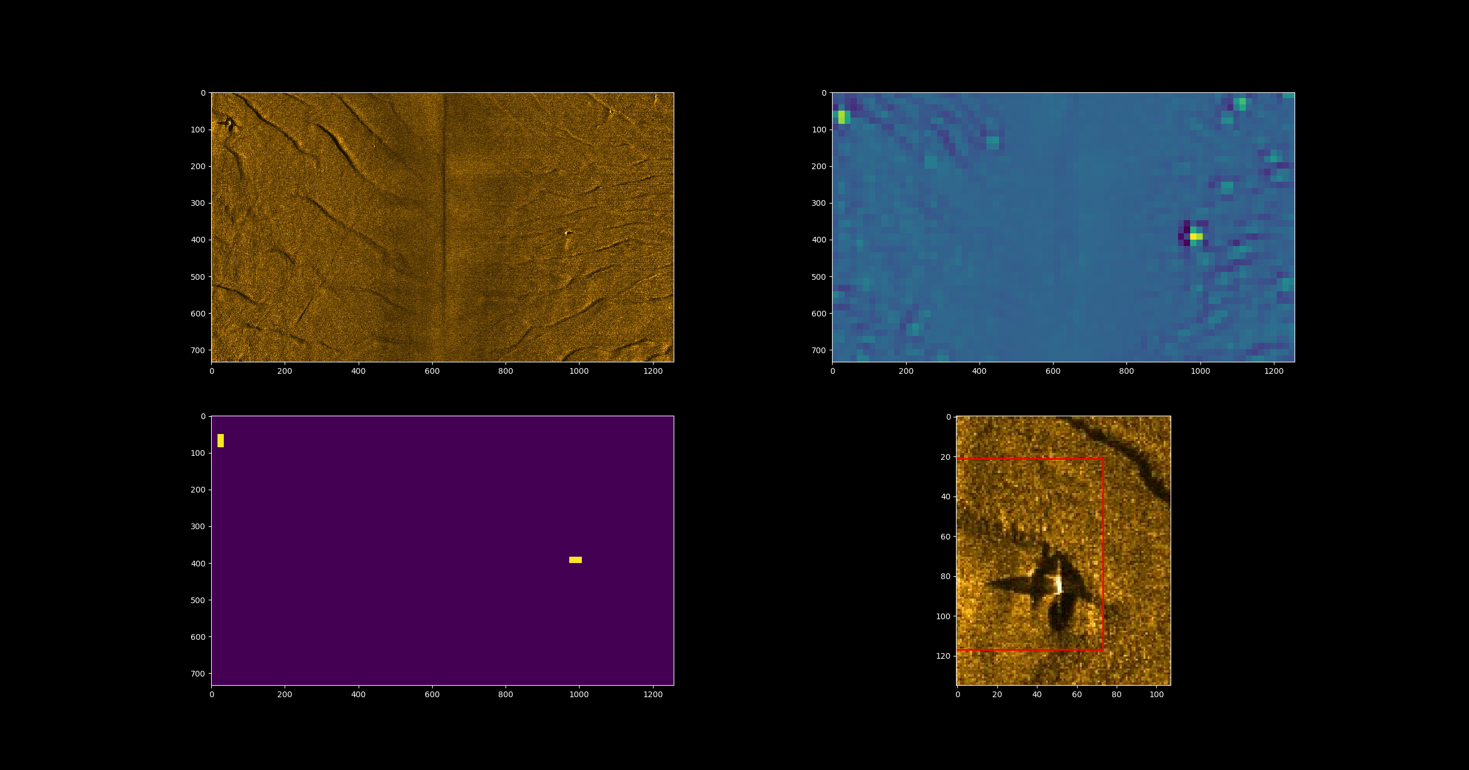
EIVA using Deep Learning for Image Recognition
U S E C A S E #3
Notes:
Black Box looks like this, in the upper left is a sidescan image with two targets. To the right is the probability heat map, and in the lower left it shows the two objects that triggered the detection.
Here, Deep learning is looking for anomalies that are not part of the natural seabed. We are unsure how the computer determines an anomaly, only that we showed it examples of seabed, and examples of other anomalies like what we wanted to find, and it is able to find more anomalies even if it has never encountered them, in future data.

Slide 28
Knowing the difference:
Machine Learning, and Deep Learning are both thrown around a lot in conversation, but how can you tell the actual difference between the two?
2
MACHINE LEARNING
Example: Can find an object in an image:
Can be trained to recognize objects
Cannot find something it hasn’t been trained to find yet, it can sort objects.
Give “more logical” results for object detected and why it chose the object
DEEP LEARNING
Example: Can find all objects in an image
Finds multiple objects with segmentation
Identifies AND labels found objects
Provides percentages but cannot point to exactly why it made that choice
Notes:
So while machine learning can do simple tasks like humans, it takes a deep learning neural network to do some of the more complex processes. If we expect one to perform like the other, the whole thing fail’s and we end up in Gartner’s trough of disillusionment.

Slide 29
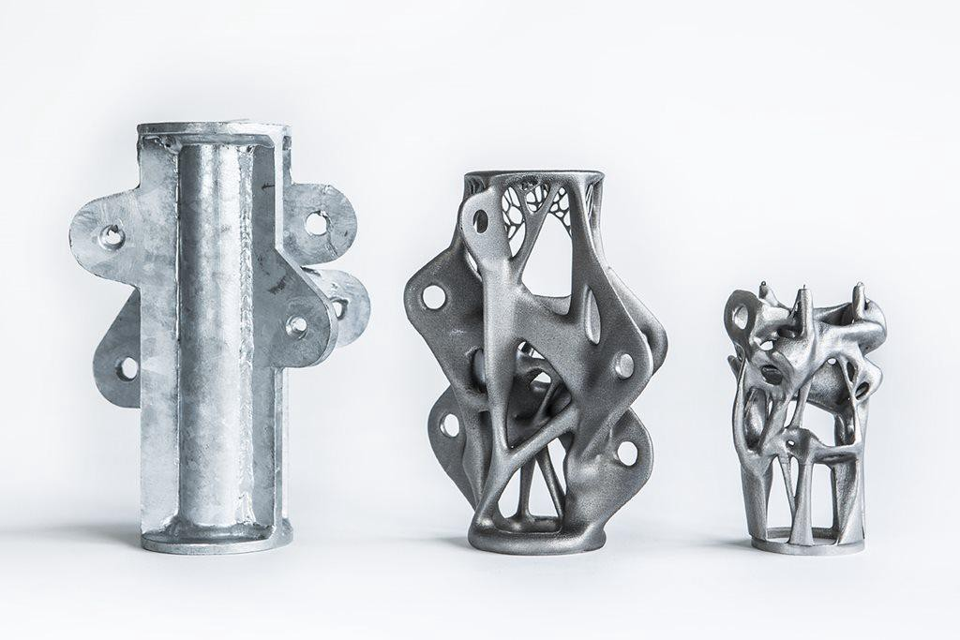
Deep Learning Engineering Creations
4
“In the case of this particular piece, the height is approximately half that of one designed for traditional production methods, while the direct weight reduction per node is 75%. On a construction project that means we could be looking at an overall weight reduction of the total structure of more than 40%. But the really exciting part is that this technique can potentially be applied to any industry that uses complex, high quality, metal products.”
Notes:
When this environment was defined: Incentive was given for weight reduction while retaining structural strength, the model found this design.
Half the size, stronger, and uses less material.
Image courtesy Medium.com

Slide 30
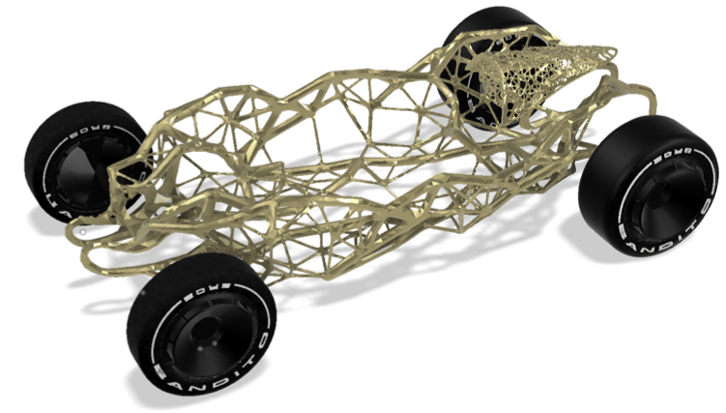
Deep Learning Creations
4
This is a car frame that is designed by a generative algorithm.
Notes:
A question that was posed in the call for papers was: Who owns the data that is collected in the field, and does that data become a company asset?
So what about this design?
With regards to this I was lucky enough to have a decision come out by the US Patent board while I was doing this, so my first question has been answered:
Image courtesy Medium.com

Slide 31

Petition Decision
US Patent Office, April 22, 2020
4
…[that] an inventor must be a natural person is reflected in the numerous references to the inventor as a “person” in Title 37 of the Code of Federal regulations
Notes:
An inventor filing for a patent must be a person.
DABUS applied for co creatorship with a human and was denied on the basis that one of the co-inventors was not a person.

Slide 32
Questions
4
For Your Consideration:
1) A computer algorithm cannot file a patent, but can a computer program violate a patent if it can teach itself without being programmed?
2) Can an algorithm violate a law that requires “knowing and willful” participation?
Contact info:
Kevin Tomanka, CH
OARS, LLC
16225 Park Ten Pl. Suite 660
Houston, TX 77084
kevin.tomanka@oarsgroup.com
Notes:
For your consideration I have a couple of things here that someone will need to start thinking about next.
A computer cannot file for a patent, but can it violate one without knowing?
And then speaking about “knowing” if a law requires a “knowing or willful” action. Can a computer program do this?
Food for thought?

